Slide 1
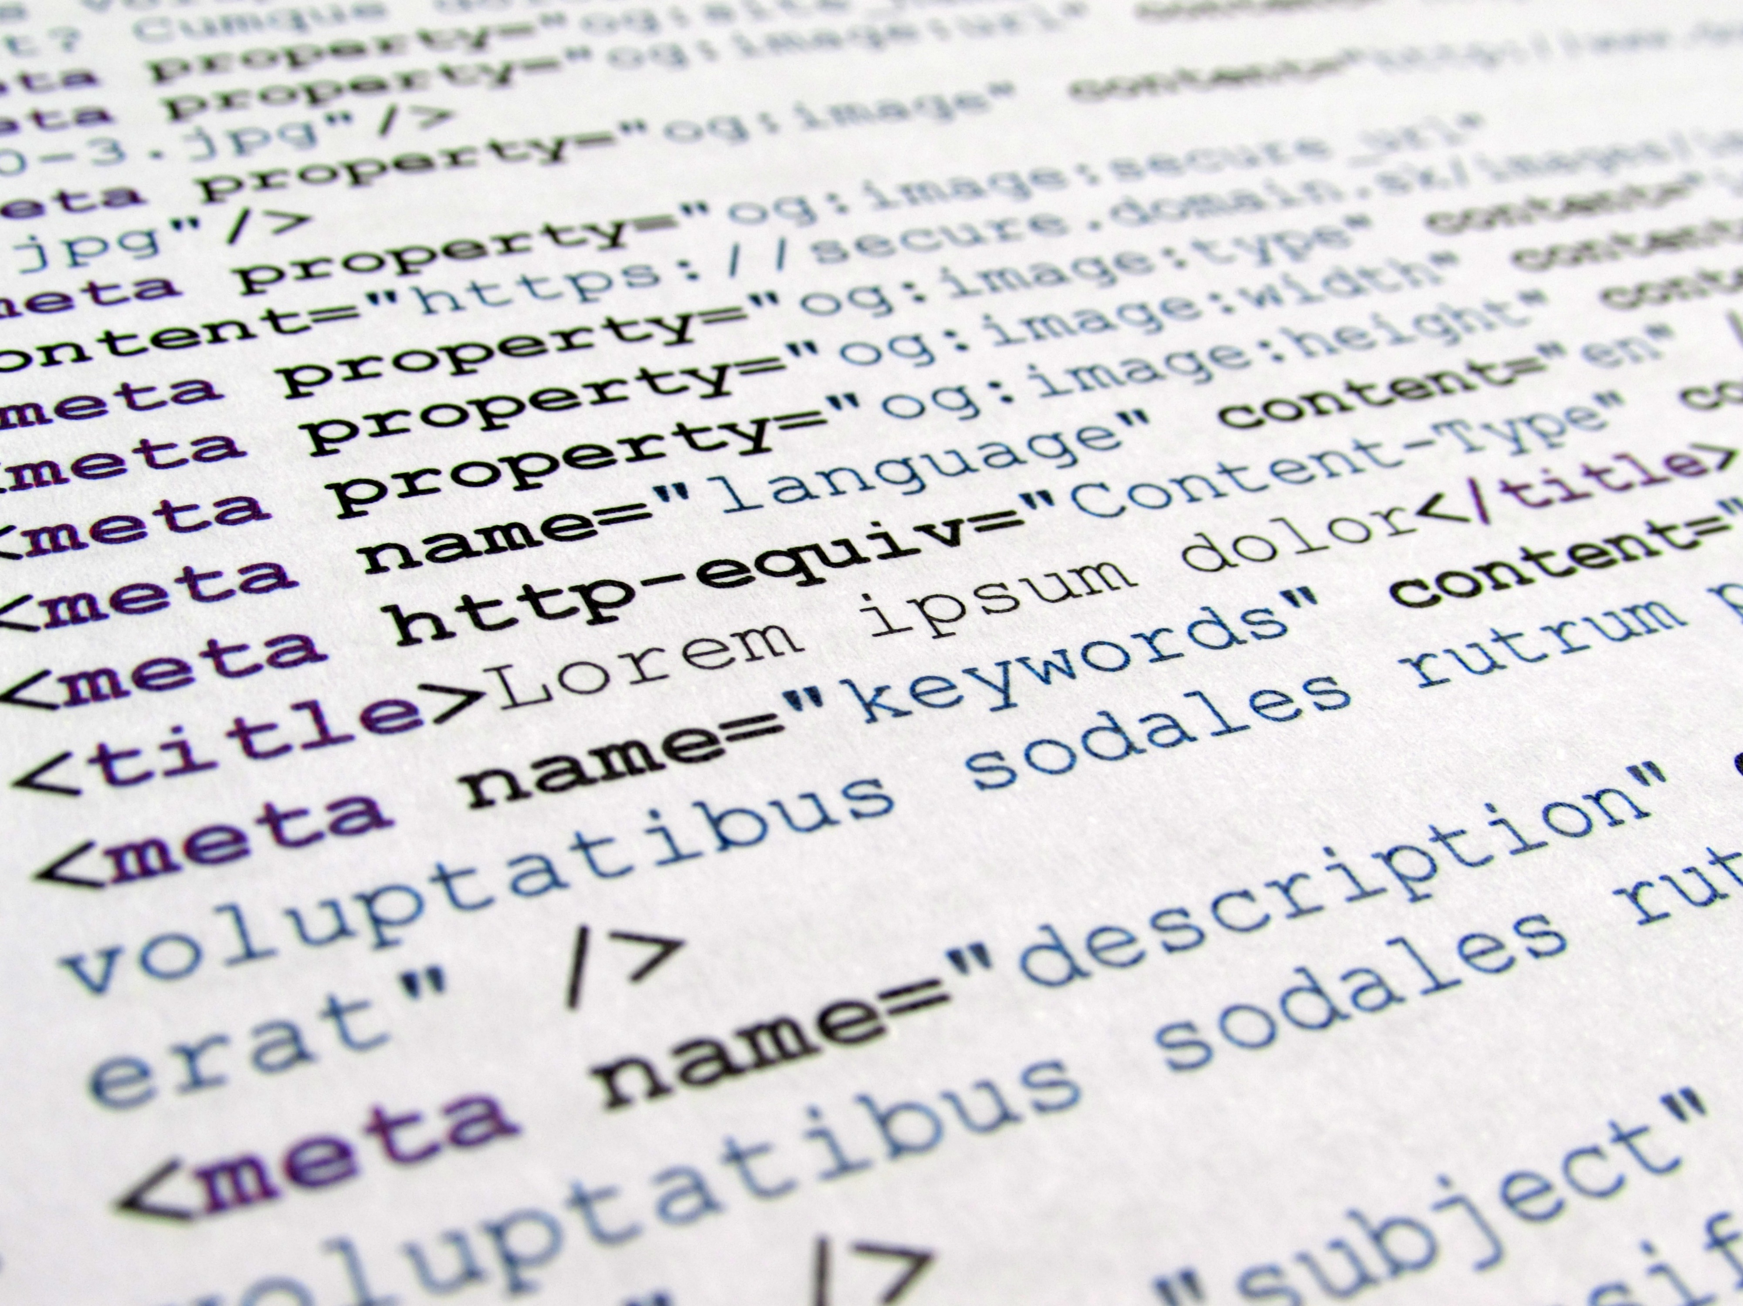

&
up running
-- w/--
progressive
|
web apps
Notes:
JOKES:
This should only take a few hours.
Around the world, around the world. Around the world, around the world. Now Daft Punk is stuck in your head.
It’s a test for a web page. Duh.
Whoa… That’s some cool animation.
It’s got a face only a mother could love.
Finally, this guy gets to some real content!
Is every slide going to have one of these lame jokes?
There are 10 kinds of people in the world. Those that understand binary, and those that don’t.
This color is #BADA55.
Fun Fact: The word “algorithm” was coined in tribute to Al Gore’s contribution to computer science.
["hip", "hip"] // first one to figure this one out and shout it out loud wins
Ugh. I hate shaving. Beards should have been designed as an opt-in feature.
1f u c4n r34d th1s u r34lly n33d t0 g0 out51d3.
Something witty goes here.
To understand what recursion is, you must first understand recursion.
Oct 31 == Dec 25, so Halloween is Christmas.
These jokes aren’t bad. They’re in “beta”.
Send complaints to: trash@molnar.com
Two bytes meet. The first byte asks, “Are you ill?” The second byte replies, “No, just feeling a bit off.”
Programming is 10% science, 20% ingenuity, and 70% getting the ingenuity to work with the science.
Have you heard about the new Cray super computer? It’s so fast, it executes an infinite loop in 6 seconds.
The generation of random numbers is too important to be left to chance.
A common programming solution is to use threads. But then, two ‘llyou hav erpoblesm.
#titanic { float: none; bottom: 0; }
#wife { right: 100%; margin: 0; }

Slide 2

Reach vs. Richness There are 10 kinds of people in the world. Those that understand binary, and those that don’t.
?


Global



Local
Text UI
Graphical UI
Natural UI

Slide 3






‘Web’ App Models Whoa… That’s some cool animation.
Adobe AIR
Palm WebOS
Apache Cordova
Microsoft WinJS
Electron
W3C Widgets

Slide 4
Progressive Web Apps Oct 31 == Dec 25, so Halloween is Christmas.
1





responsive
work offline
app like
fresh
safe
2

⬄


3
discoverable
re-engageable
installable
linkable

Slide 5
1

work offline.

Slide 6
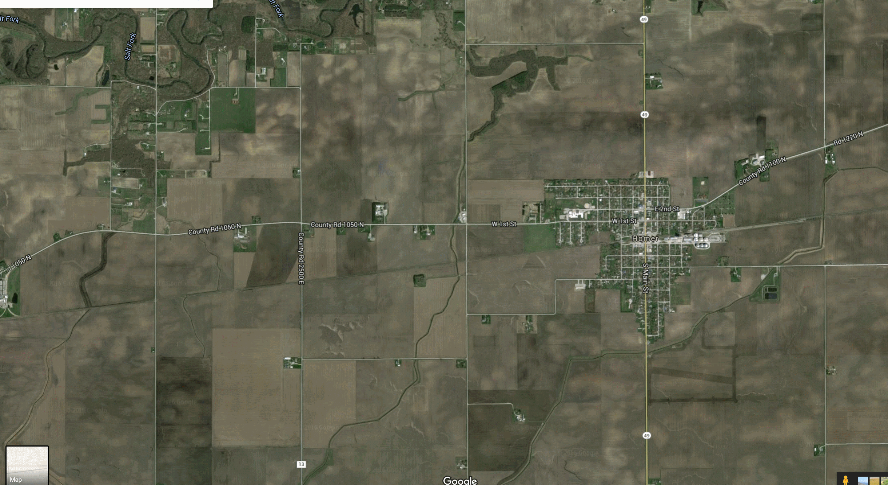


Notes:
Tell story of how on On June 4th at the homer soda festival I was going to use my app
Let me show you the app

Slide 7
about our company
❒



transport
crowds
inside
lie-fi

Slide 8
Service Worker Overview 1f u c4n r34d th1s u r34lly n33d t0 g0 out51d3.





Slide 9
Service Worker Overview 1f u c4n r34d th1s u r34lly n33d t0 g0 out51d3.






Slide 10
Service Worker Overview 1f u c4n r34d th1s u r34lly n33d t0 g0 out51d3.







Slide 11
2

installable.

Slide 12
App Manifest
Finally, this guy gets to some real content!
<link rel="manifest" href="/manifest.json">

Slide 13
App Manifest
Finally, this guy gets to some real content!
<link rel="manifest" href="/manifest.json">
{
"name": "SodaPopped",
"short_name": "SodaPopped",
"start_url": "/",
"background_color": "#3498DB",
"theme_color": "#34495E",
"orientation": "portrait-primary",
"display": "standalone",
"icons": [{
"src": "/path/to/image.ext",
"type": "image/png",
"sizes": "192x192"
}]
}

Slide 14
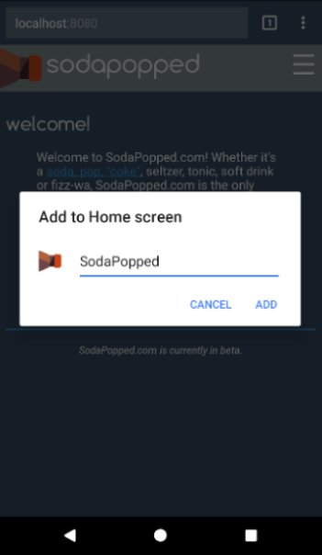
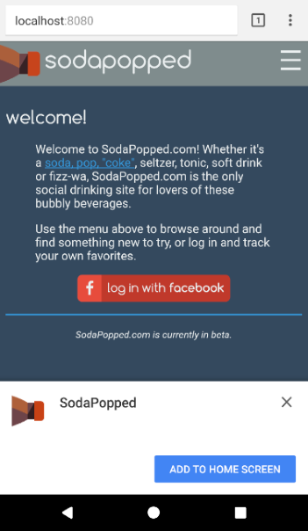
App Manifest
Finally, this guy gets to some real content!
<link rel="manifest" href="/manifest.json">
{
"name": "SodaPopped",
"short_name": "SodaPopped",
"start_url": "/",
"background_color": "#3498DB",
"theme_color": "#34495E",
"orientation": "portrait-primary",
"display": "standalone",
"icons": [{
"src": "/path/to/image.ext",
"type": "image/png",
"sizes": "192x192"
}]
}
Identity

Slide 15
App Manifest
Finally, this guy gets to some real content!
<link rel="manifest" href="/manifest.json">
{
"name": "SodaPopped",
"short_name": "SodaPopped",
"start_url": "/",
"background_color": "#3498DB",
"theme_color": "#34495E",
"orientation": "portrait-primary",
"display": "standalone",
"icons": [{
"src": "/path/to/image.ext",
"type": "image/png",
"sizes": "192x192"
}]
}
Presentation

Slide 16
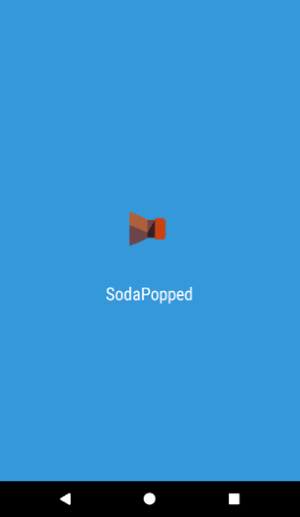
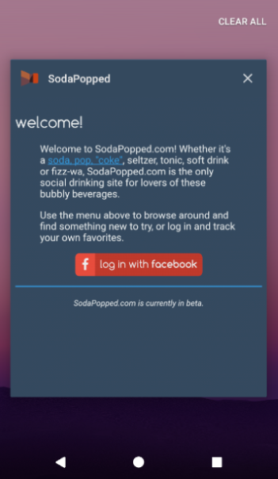
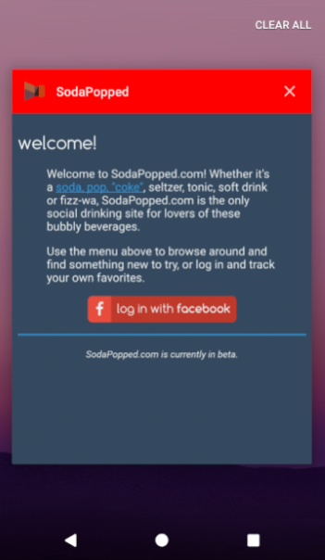
App Manifest
Finally, this guy gets to some real content!
<link rel="manifest" href="/manifest.json">
{
"name": "SodaPopped",
"short_name": "SodaPopped",
"start_url": "/",
"background_color": "#3498DB",
"theme_color": "#34495E",
"orientation": "portrait-primary",
"display": "standalone",
"icons": [{
"src": "/path/to/image.ext",
"type": "image/png",
"sizes": "192x192"
}]
}
Presentation

Slide 17
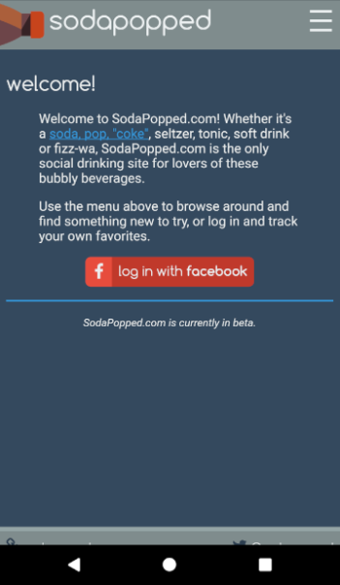
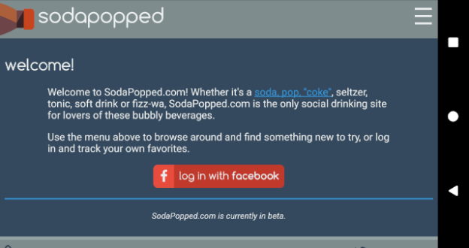
App Manifest
Finally, this guy gets to some real content!
<link rel="manifest" href="/manifest.json">
{
"name": "SodaPopped",
"short_name": "SodaPopped",
"start_url": "/",
"background_color": "#3498DB",
"theme_color": "#34495E",
"orientation": "portrait-primary",
"display": "standalone",
"icons": [{
"src": "/path/to/image.ext",
"type": "image/png",
"sizes": "192x192"
}]
}
Presentation

Slide 18
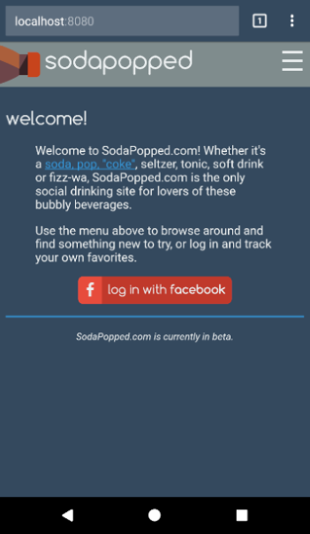
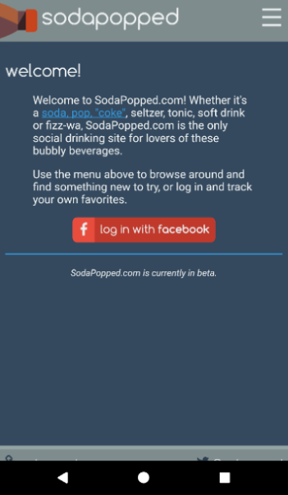
App Manifest
Finally, this guy gets to some real content!
<link rel="manifest" href="/manifest.json">
{
"name": "SodaPopped",
"short_name": "SodaPopped",
"start_url": "/",
"background_color": "#3498DB",
"theme_color": "#34495E",
"orientation": "portrait-primary",
"display": "standalone",
"icons": [{
"src": "/path/to/image.ext",
"type": "image/png",
"sizes": "192x192"
}]
}
Presentation

Slide 19
App Manifest
Finally, this guy gets to some real content!
<link rel="manifest" href="/manifest.json">
{
"name": "SodaPopped",
"short_name": "SodaPopped",
"start_url": "/",
"background_color": "#3498DB",
"theme_color": "#34495E",
"orientation": "portrait-primary",
"display": "standalone",
"icons": [{
"src": "/path/to/image.ext",
"type": "image/png",
"sizes": "192x192"
}]
}
Icons


Slide 20
Install Banner Requirements A common programming solution is to use threads. But then, two ‘llyou hav erpoblesm.
secure site with green lock icon
registered service worker
offline experience
app manifest with:
name
short_name
icons at least 144x144
start_url
display = standalone | fullscreen

Slide 21
3
⬄
re-engageable.

Slide 22




Web Push Overview 1f u c4n r34d th1s u r34lly n33d t0 g0 out51d3.





configure push


Slide 23
Web Push Overview 1f u c4n r34d th1s u r34lly n33d t0 g0 out51d3.





configure push
send message


Slide 24
Web Push Overview 1f u c4n r34d th1s u r34lly n33d t0 g0 out51d3.



⬄
1


configure push
send message

receive message


Slide 25
4
✴
tools.

Slide 26





Lighthouse
Finally, this guy gets to some real content!
built by Google
open source
Chrome extension
npm module


Slide 27
Reach vs. Richness There are 10 kinds of people in the world. Those that understand binary, and those that don’t.
future is
promising


Global



Local
Text UI
Graphical UI
Natural UI

Slide 28

thanks!
Questions & Answers
Send complaints to: trash@molnar.com

nikmd23
·
nikcodes.com
pluralsight
https://nikcodes.com/pwa-fundamentals

